Slide 1


Slide 2
Can machine learning algos outperform the stock market?
TWO CLASSES
Outperform the S & P 500 Index of US stocks.
12 month percentage return GREATER than 12 month SP 500 return
Underperform
12 month percentage return LESS than SP 500

Slide 3
DATA
1022 ROWS of STOCK DATA WITH 76
FUNDAMENTAL EQUITY FEATURES
CASE-SCHILLER HOME PRICE INDEX
30 YEAR MORTGAGE RATES
BILLION DOLLAR DISASTERS

Slide 4
LOGISTIC REGRESSION
ACCURACY SCORE OF .68
PRECISION OF .67
ROC SCORE .64

Slide 5
Logistic Regression (10 fold Cross Val)
Random Forest (grid search)
ACCURACY SCORE OF .68
PRECISION OF .67
ROC SCORE .64
ACCURACY SCORE OF .68
PRECISION OF .67
ROC SCORE .59

Slide 6
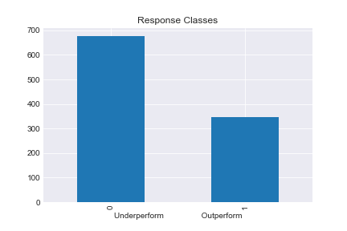

HOW CAN WE IMPROVE OUR METRICS?

Slide 7
Logistic Regression with Resample
Random Forest with
Resample
ACCURACY .63
PRECISION .68
ROC .64
ACCURACY
.66
PRECISION .69
ROC
.56

Slide 8
Random Forest Precision .67 to .69
Best Metric for evaluating model
False positives are costly
Higher Precision is more valuable than recall.

Slide 9
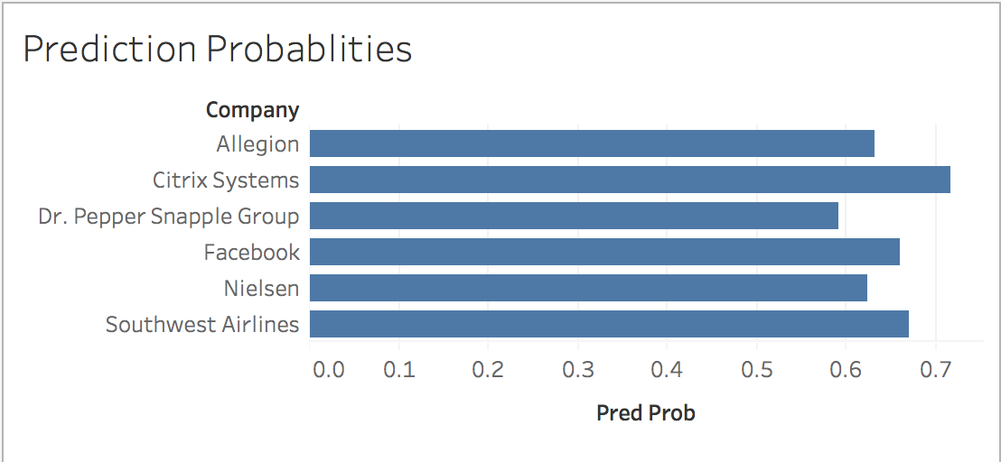
Ways to profit when you’re right ~ 60%

Slide 10
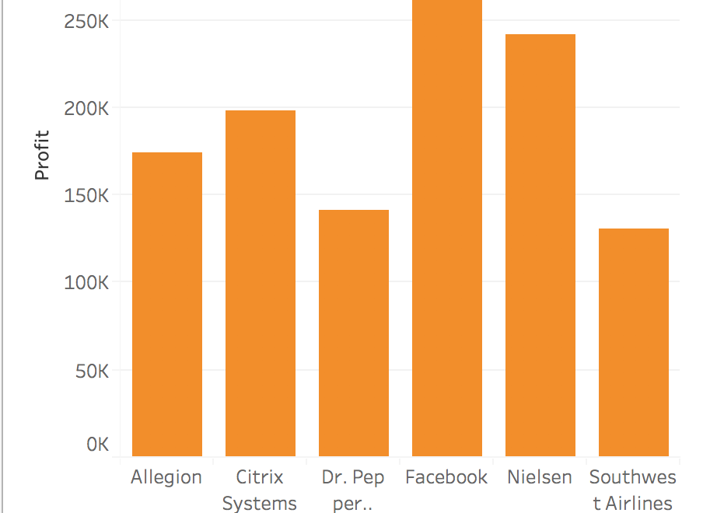
Profit on $1m: MODEL $1,211,255 vs. $117,700 SP

Slide 11
Conclusions and Lessons
Upsampling may not help
Get more data
Better feature engineering
A decent model can still be valuable
Interesting Insight
30 year mortgage rates consistently had a top importance score across iterations.
Perhaps an avenue for more research?

